Slide 1
MODULE-4
One point perspective projection
Two point perspective projection

Slide 2
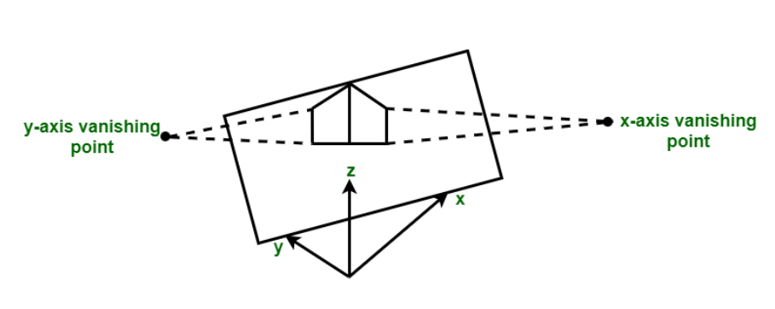
two point projection
Two point perspective projection occurs when projection plane intersects two of principal axis.
In the above figure, projection plane intersects x and y axis where as z axis remains parallel to projection plane.

Slide 3

The perspective-projection transformation of a viewing-coordinate position is then accomplished in two steps. First, we calculate the homogeneous coordinates using the perspective- transformation matrix:

Slide 4
Where, Ph is the column-matrix representation of the homogeneous point (xh, yh, zh, h) and P is the column-matrix representation of the coordinate position (x, y, z, 1).  Second, after other processes have been applied, such as the normalization transformation and clipping routines, homogeneous coordinates are divided by parameter h to obtain the true transformation-coordinate positions.  The following matrix gives one possible way to formulate a perspective- projection matrix.

Slide 5
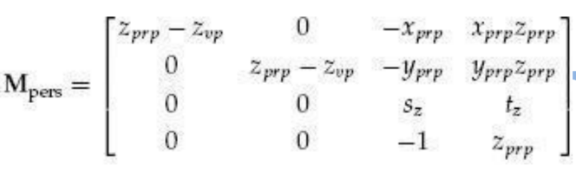
Parameters sz and tz are the scaling and translation factors for normalizing the
projected values of z-coordinates.
 Specific values for sz and tz depend on the normalization range we select.

Slide 6
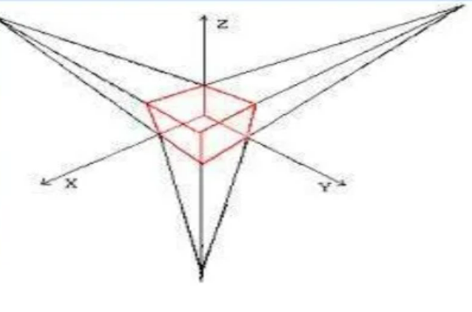
THREE POINT PROJECTION
Three point perspective projection occurs when all three axis intersects with projection plane. There is no any principle axis which is parallel to projection plane.
Three point projection is used less frequently as it adds little extra realism to that offered by two point perspective projection

Slide 7
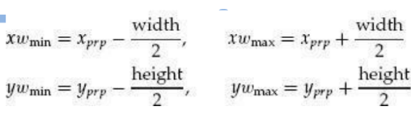
SYMMETRIC PERSPECTIVE PROJECTION
The line from the projection reference point through the center of the clipping window and on through the view volume is the centerline for a perspective projection frustum.
➔ If this centerline is perpendicular to the view plane, we have a symmetric frustum (with respect to its centerline)

Slide 8
THANK YOU

